Slide 1
Identity Management
Sprint 6
Jacob Gianakopoulos, Steven Scott, Samuel Vitale, Alex Bowen, Andy Jolagh, Nick Attisha

Slide 2

Sprint 6 Preview
Facial Recognition
Server
OAuth2
Rework UI

Slide 3
Sprint 6 Tasks:
Facial Recognition
Add in details that was mentioned in previous meeting with the professor as well as advice given in class for the facial recognition.
App improvements
Focused on smaller features and textures that were missing in the UI for convenience.
OAuth2
Allow developers to add our login functionality to their website

Slide 4
Server
This sprint’s goal was to run everything on the server.
Most of the effort went into troubleshooting configuration issues.
OpenCV installation brought with it a host of obstacles.
Currently, Google Cloud is failing to allow ssh login.

Slide 5
Lessons Learned and Server Solutions
Must rebuild the server from scripts to prevent similar issues setting us back.
Keep snapshots of the server state. Rolling back is far preferable.
Some problems seem to be caused by server’s memory limit. Have to upgrade the specs.
If problems persist, we may have to use a local server instead of Google Cloud.

Slide 6
Backend
Developer Accounts
Registration
Sign-In
Account Page
OAuth2

Slide 7
OAuth2
Workflow
Third-party site creates a link to our authorization server (using the credentials from their developer account and a random verification token)
The user is redirected to our login site using that link
User enters their credentials and shares their face in order to sign-in
On a valid sign-in, our authorization server returns an authorization code and the verification token originally sent by the third-party site
The Third party site uses the authorization code (and their secret ID) to get an access token
That token will be used to access the users information for a limited time (it expires)
Still to do
Finish workflow implementation (from access token step)
Ask user for permission to give certain information (email, name, etc). If no permissions are given, just pass the unique User Identifier

Slide 8
OAuth2 Demo

Slide 9
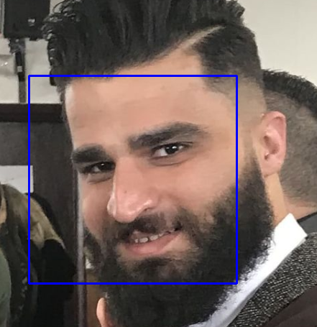
Facial Recognition Progress
Facial Recognition is done. Ended up using the facial_recognition API with python. Having issues installing the API on the ubuntu server so for right now it only works locally on a windows machine
Will be demoed

Slide 10
Facial Recognition Demo

Slide 11
Future User Stories
As a user, I want to be able to sign in with my face with ease.
As a user, I want my information to be protected and secure.
As a developer, I want to allow users to login to my website using their Identity Management accounts

Slide 12

Major Tasks Going Forward
1
2
Server Solution
Ensure everything is fully integrated.
Upgrade current server to meet our needs.
Use a better backup strategy.
Complete OAuth2
Fully implement Facial recognition sign-in
Allow developers to turn their authorization tokens into access codes
Let users decide how much of their information they want to give to each website

